Slide 1


OBJECT ORIENTED PROGRAMMING THROUGH JAVA

Slide 2

L11-TYPE CONVERSION
AND TYPE CASTING

Slide 3


Slide 4
Java’s Automatic Conversions
When one type of data is assigned to another type of variable, an automatic type conversion will take place if the following two conditions are met:
The two types are compatible.
The destination type is larger than the source type.
When these two conditions are met, a widening conversion takes place.
For example, the int type is always large enough to hold all valid byte values, so no explicit cast statement is required.

Slide 5
Casting Incompatible Types
For example, what if you want to assign an int value to a byte variable? This conversion will not be performed automatically, because a byte is smaller than an int. This kind of conversion is sometimes called a narrowing conversion, since you are explicitly making the value
(target-type) value
narrower so that it will fit into the target type. To create a conversion between two incompatible types, you must use a cast. A cast is simply an explicit type conversion. It has this general form: Here, target-type specifies the desired type to convert the specified value to.

Slide 6
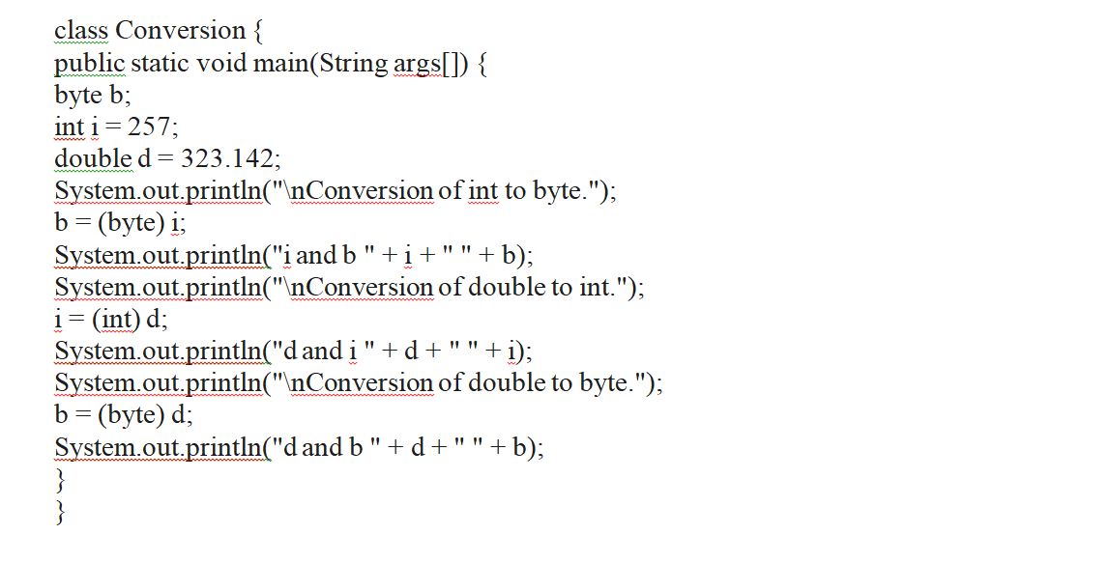

Slide 7
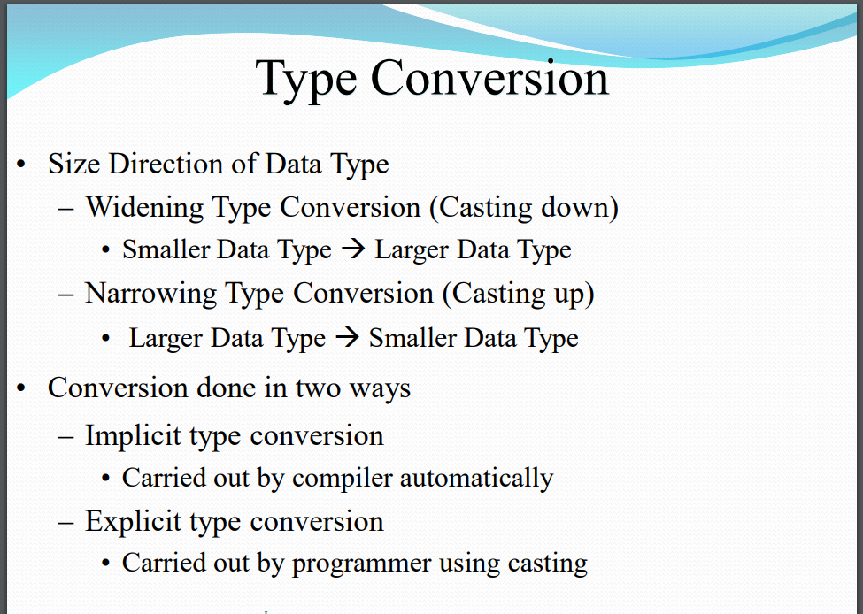
TYPE CONVERSION AND TYPE CASTING-

Slide 8
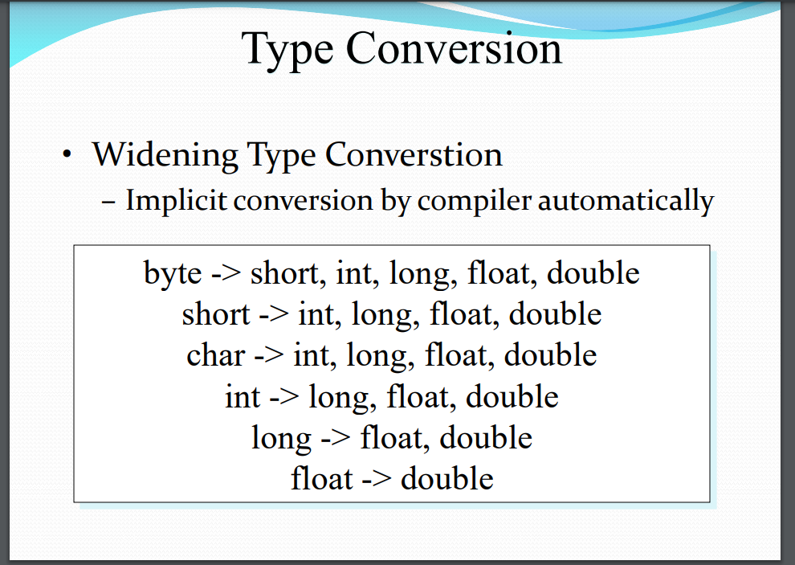

Slide 9
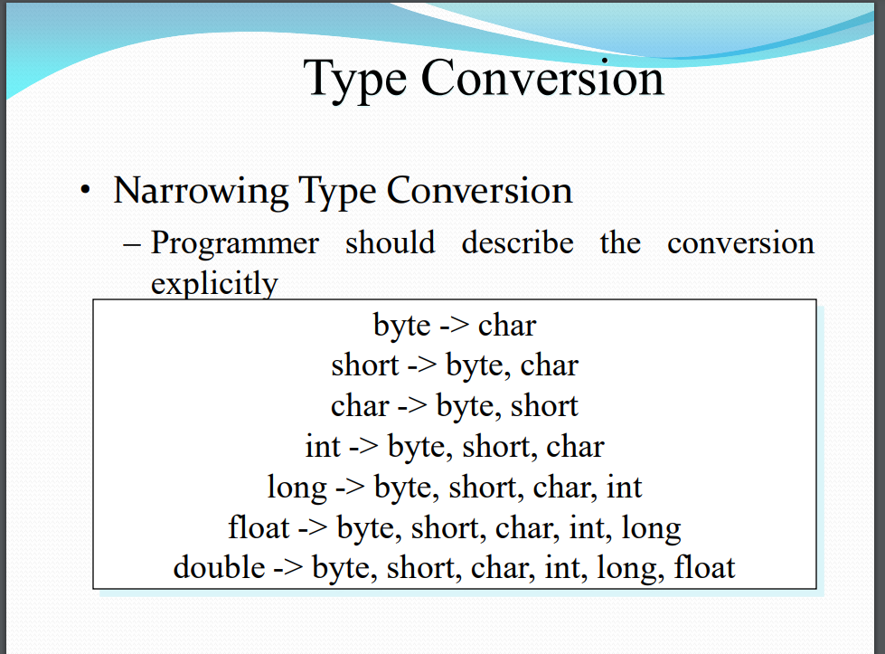

Slide 10
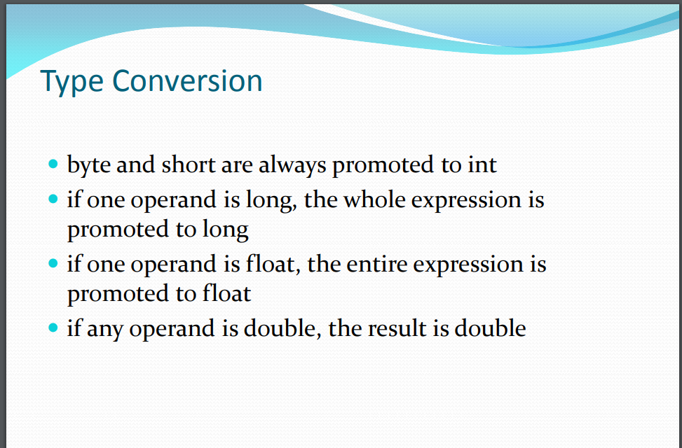

Slide 11
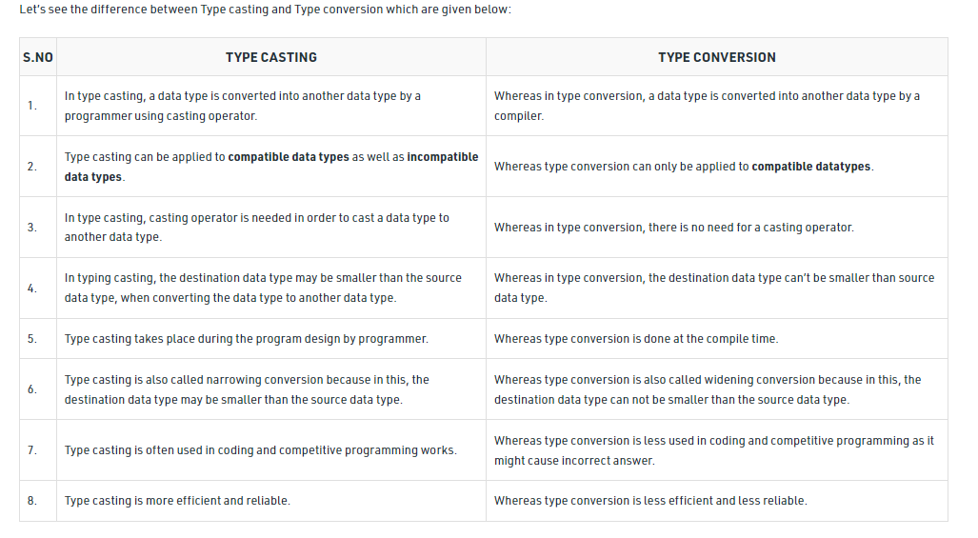

Slide 12

Next….
SIMPLE JAVA PROGRAM
Notes:
In Slide Show mode, click the arrow to enter the PowerPoint Getting Started Center.

Slide 13



